Slide 1
Omnidata: A Scalable Pipeline for Making Multi-Task Mid-Level Vision Datasets from 3D Scans
Group 6
Rishikesh Jadhav, Aniruddh Balram, Patrik Pordi, Jingxi Chen, Ji-Ze Jang, Quynh Thi Phung
Scribe : Rishikesh Jadhav

Slide 2
What problem are they trying to solve?
Data Scarcity: The datasets often focus on specific tasks like object recognition, leaving other vision tasks underrepresented.
Data Quality and Annotations: Generating high-quality annotations for vision tasks like surface normal estimation and depth estimation can be labor-intensive and costly
Lack of Diverse Vision Tasks: Existing datasets are often biased towards recognition tasks and may not cover a wide range of vision tasks, such as depth estimation, surface normal estimation, and panoptic segmentation
Limited Control over Data Generation : The authors recognize the need for more control over the data generation process, including factors like camera intrinsics, scene lighting, and data domain
Authors Solution :
Data Scarcity: Generating multi-task mid-level vision datasets from 3D scans.
Data Quality and Annotations: Automating annotation generation for tasks like surface normal and depth estimation.
Lack of Diverse Vision Tasks: Creating datasets that cover a wide range of vision tasks beyond recognition.
Limited Control over Data Generation : Providing control over data generation parameters to researchers for customization.

Slide 3
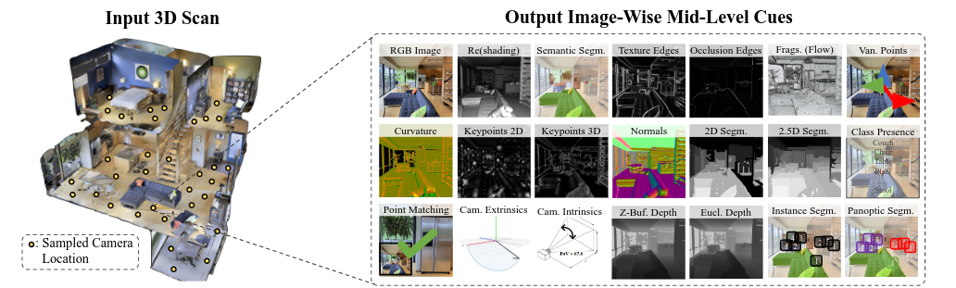
INTRODUCTION
The main concept is to create a pipeline for “steerable” (highly adaptable) computer vision datasets from 3D scans, leveraging mid-level cues for training vision models.
Simple steps:
1. Camera and Point Sampling
2. View Sampling (Wide-baseline multi-view, Smooth trajectory sampling)
3. Rendering Mid-level Cues

Slide 4
RELATED WORK
Static 3D Datasets : Many recent datasets rely on 3D scans, but they often focus on specific domains. Omnidata offers diversity across scenes and objects.
Vision-Focused Simulators: While simulators use 3D meshes, Omnidata bridges the gap between simulators and static vision datasets, prioritizing realism.
Linking 2D Images and 3D Meshes : Rely on hand-annotation, which is expensive and time-consuming.
Multi-Task Datasets: Existing multi-task learning (MTL) datasets often specialize in recognition tasks. Omnidata aims for a more comprehensive, real-world setting.
Data Augmentation + Domain Randomization(RL): Omnidata leverages a rich set of data augmentations, including including viewpoint consistency and Euclidean transforms, for static computer vision datasets, enhancing model robustness.
Auto Labeling: The pipeline harnesses the structure in 3D scans to efficiently compute and propagate labels, reducing annotation effort(basically the use pretrained models to reduce manual efforts).

Slide 5
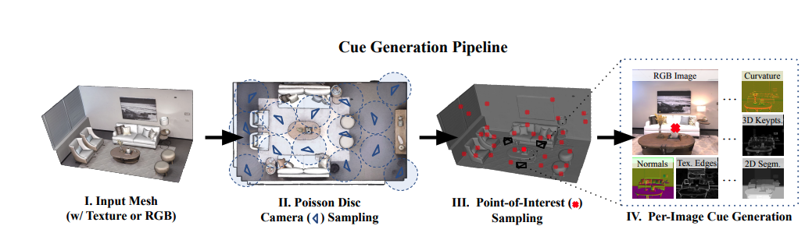
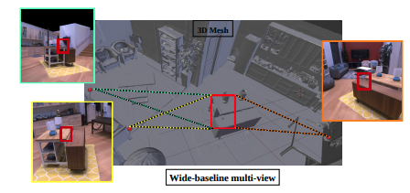
PIPELINE OVERVIEW
The annotator generates camera locations and points-of-interest along the mesh. (Filtering- each camera sees at least one point, and each point is seen by a minimum number of cameras (default: 3)
For each camera and each point-of-interest, it creates a view from that camera fixated on the point.
For each space-point-view triplet, the annotator renders all the mid-level cues

Slide 6
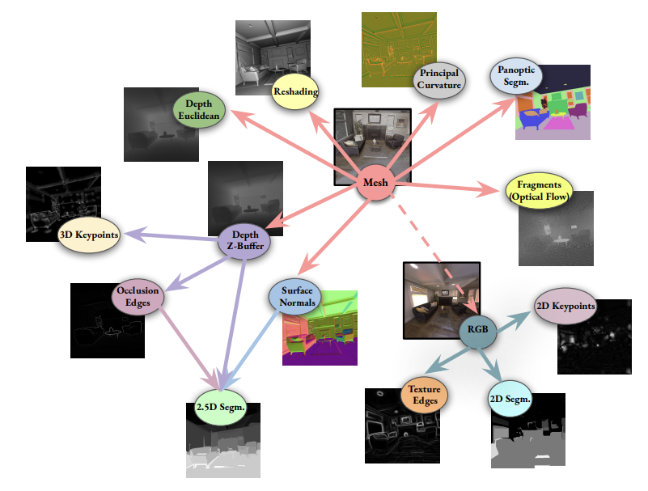
How are all of these cues generated?
The pipeline uses some of the mid-level cues to produce others.

Slide 7
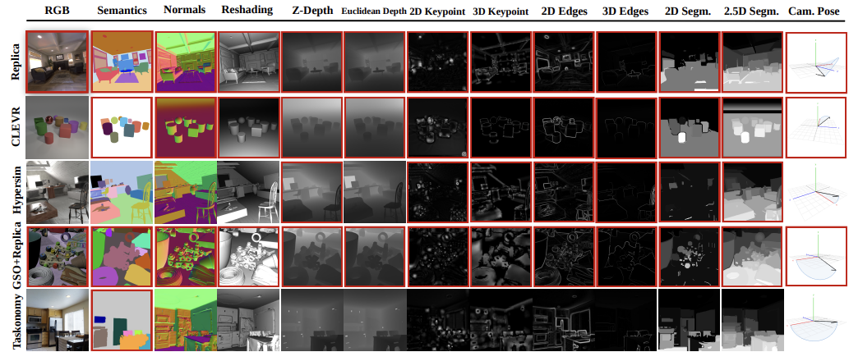
Mid-level cues provided for the starter set.

Slide 8
STARTER DATASET OVERVIEW
The starter data is generated from seven mesh-based datasets, categorized as follows:
Indoor scene datasets: Replica, HyperSim, Taskonomy, Habitat-Matterport (HM3D).
Aerial/outdoor datasets: BlendedMVG.
Diagnostic/Structured datasets: CLEVR.
Object-centric datasets: generated by placing Google Scanned Objects around buildings in the Replica dataset, following the approach used by ObjectNet for image diversity in classification(simulation).
The Starter Dataset is a large dataset annotated with Omnidata's annotator, containing a diverse range of images from various scenes

Slide 9
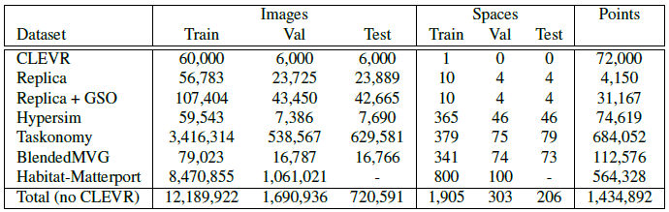
RESULTS
Dataset statistics

Slide 10
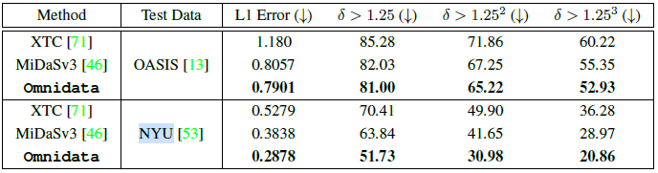
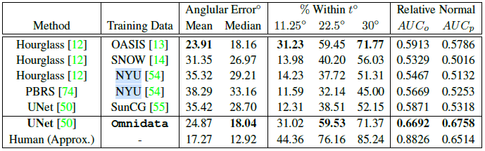
RESULTS
Zero-shot depth estimation
Zero-shot surface normal estimation (check AUC for Unet + Omnidata)

Slide 11
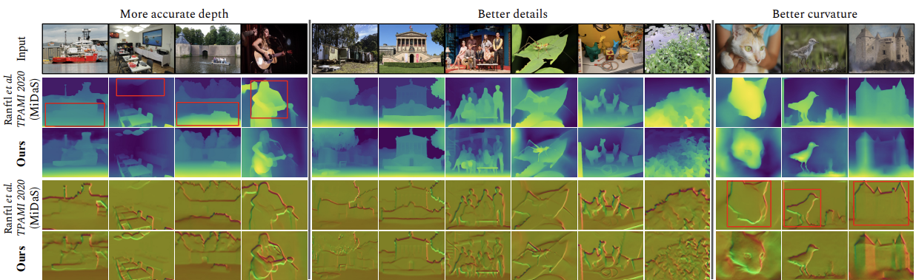
Qualitative comparison with MiDaS on zero-shot OASIS depth estimation
Rectangular boxes show regions useful for comparison.

Slide 12
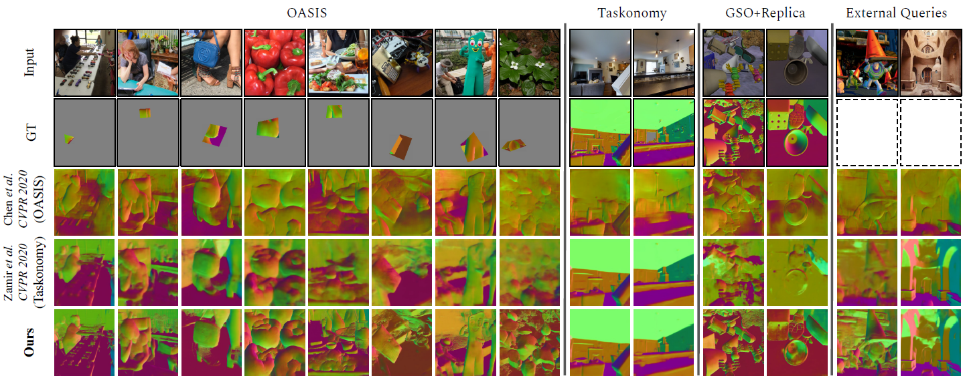
Qualitative results of zero-shot surface normal estimation

Slide 13
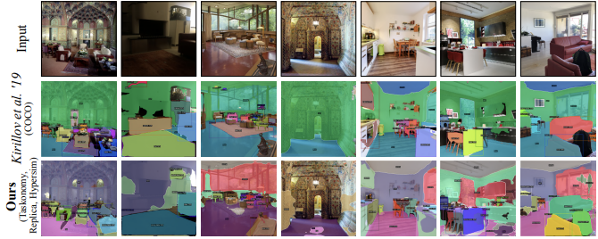
Qualitative results of panoptic segmentation with PanopticFPNs trained on COCO and Omnidata
The Omnidata model trained jointly on Taskonomy, Replica, and Hypersim shows good performance on indoor scenes without people.

Slide 14
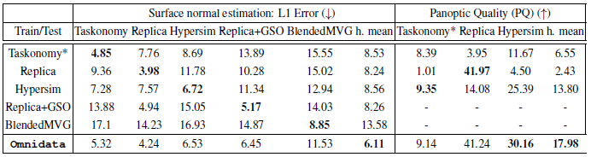
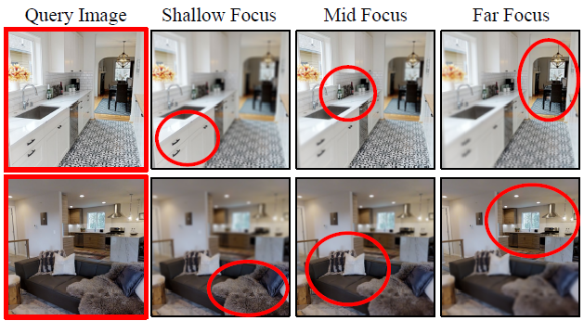
ILLUSTRATIVE DATA-FOCUSED ANALYSES
(One For All)
Inter-dataset domain transfer
performance for surface normal
estimation and panoptic
Segmentation(starter dataset test).
Image refocusing augmentation on
Taskonomy(for better generalization
performance).

Slide 15
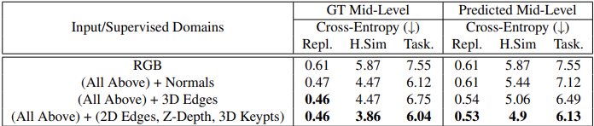
Are Mid level Cues as inputs useful???
Semantic segmentation results using models trained on Replica and tested on Replica, Hypersim and Taskonomy.
These models received mid-level cues as input(except RGB).
As we can see the models notably benefited from the mid-level cues.

Slide 16
CONCLUSION AND LIMITATION
Summary:
This paper presented a way to generate better quality data for training visual learning tasks from 3D scans
The authors show the improvement/effect by their “camera and point sampling” and “view sampling” on better FOV, viewing angle and viewing distance distribution for generated data .
Limitation:
The “camera and point sampling” in the paper is to designed to densely sampling the 3D space, however this does not lead to better sampling in “semantic objects”
For the generated RGB images from mesh, the quality may not be that high (or requires super fine-grained mesh -> huge storage space)

Slide 17
Resources and References
Resources:
Pipeline Code and Docs: Simplifies technology adoption.
Docker Container: Includes required software for easy setup.
PyTorch Dataloaders: Efficiently loads dataset.
Starter Dataset: Contains 14.5M labeled images.
Convenience Utilities: Aid data management and mesh filtering.
Pretrained Models: Includes MiDaS implementation.
References:
Link to the paper : https://arxiv.org/abs/2110.04994
Link to the website : https://omnidata.vision/
Link to the Video : https://www.youtube.com/watch?v=jAXaASBB5N0&t=70s

